Slide 1



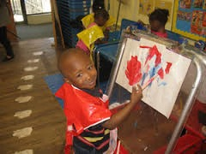

Durham’s Community Early Education/Preschool Task Force

Slide 2
Durham’s Community Early Education/Preschool (CEE/P) Task Force
School Board Resolution
County and City Resolutions
In support of universal access to high-quality preschool for all 3- and 4-year-olds in Durham County
In support of universal access to pre-kindergarten and other appropriate strategies to improve early literacy in Durham County

Slide 3
Major tasks of the Task Force
Convene a Task Force for 6‒8 months
Scan Durham’s current capacity for providing high-quality preschool services
Review what other communities have done and what works
Recommend standards for quality, potential options for funding, ways to evaluate progress, and next steps

Slide 4

CONVENE

Slide 5
Task Force membership
7 support personnel
Administration, editing, research, and graphic design
17 additional subcommittee members
5 technical advisors
Researchers and content
21 Task Force members
Public and private providers, advocacy organizations, researchers, business, county, and city
Timeline: Draft report and recommendations were due to elected bodies in Spring 2017

Slide 6
Four subcommittees
Evaluation (5 members)
Develop the approach for evaluation and identify key questions
Finance (9 members)
Research and synthesize options for funding expanded care
High-quality preschool (21 members)
Identify best practices for expanding high-quality care
Outreach (8 members)
Develop plan for gathering input and feedback from parents and informing public about the value of expanding pre-K

Slide 7
Timeline
May 2016–June 2016
Public and private providers, advocacy organizations, researchers, business, county, and city accepted appointments to the Task Force
June 2016–April 2017
Whole Task Force met 11 times and received committee updates and special presentations
Each subcommittee developed its own schedule, often meeting monthly with smaller teams working between meetings
Subcommittee membership overlapped intentionally
May 2017–August 2017
Outreach Subcommittee will engage several stakeholders to gather feedback and increase awareness
Incorporate stakeholder input into final report

Slide 8
Purpose by Consensus
Task Force work
The purpose of Durham’s Community Early Education/Preschool Task Force is to develop a plan to serve all 3- and 4-year-olds in Durham County in high-quality preschool by 2023. This plan will first serve 4-year-olds, prioritizing children in low-income families, by August 2019.

Slide 9
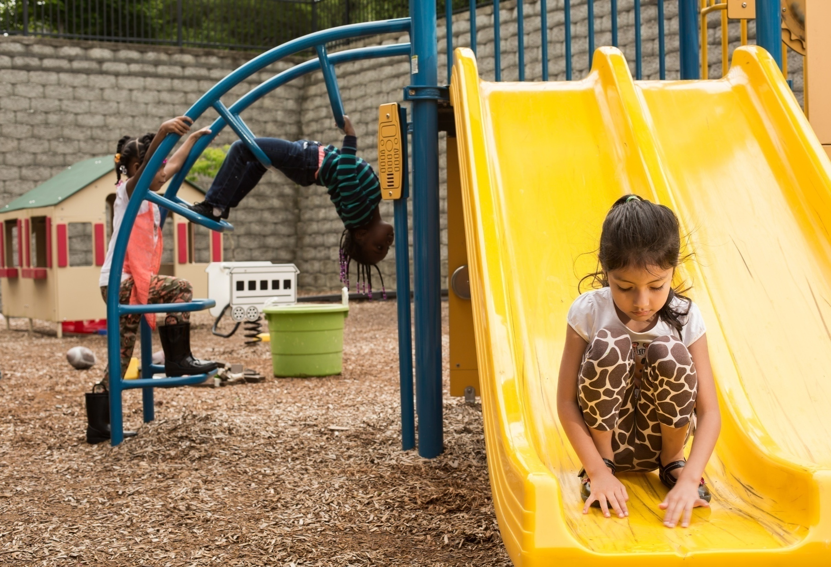
SCAN

Slide 10
How ready are our kindergarteners?
One test (mClass) has been used for several years to measure kindergarten proficiency in reading
In 2014‒15,
Overall, 35% of NC’s children were proficient in reading upon entering kindergarten
In Durham, 3,017 kindergarteners were assessed (charter and regular schools combined)
NOTE: As of the end of 3rd grade, 47% of DPS students score at or above 3rd grade level on EOG in reading (2014‒15).
*State of Durham County’s Young Children, 2017

Slide 11
Children taking the kindergarten readiness test* (N = 3,017)
*2014‒15 K Reading Proficiency Test Data in State of Durham County’s Young Children, April 2017

Slide 12
Overall, 38% of Durham’s kindergarteners were proficient in reading (2014‒15)…
…Some groups were much more proficient than others
n=3,017
n=1.389
n=67
n=3564
n=929
n=68
Source: State of Durham County’s Young Children, 2017

Slide 13
What does that mean in terms of actual children? Of the 3,017 tested (2014-15)…
…1,150 were proficient in reading and 1,867 were not
Source: Duke Center for Child and Family Policy, April 2017

Slide 14
Just over ¼ of households with 4-year-olds are really struggling economically
Federal Poverty Level | # of 4-year-olds | # of 3-year-olds
<100% (Durham 2015 rate = 26.1%) | 1,161 | 1,149
<200% (Durham 2015 rate = 47%) | 2,091 | 2,068
Source: NC Office of Budget and Management, Projected County Totals by Single Years of Age; American Community Survey, 5-year estimates

Slide 15
Some programs’ eligibility cutoffs are very strict, leaving out many of Durham’s families*
$64,553
Durham Median Family Income
$59,485
NC Median Family Income
200%
Federal Poverty Level
$54,478
Early Head Start/Head Start
DSS Child Care Subsidy Vouchers
CCSA and Durham Smart Start
Durham HUD
NC Pre-K
$50,900
$42,112
$40,840
$20,420
*Family of Three Income Eligibility Crosswalk. See Task Force Report, Attachment 1

Slide 16
In Durham, monthly fees for full-time high-quality care for 4- and 5-year-olds vary widely
5-Star
NC Pre-K, B‒K Teacher Reimbursement ($944)
Most Expensive
($1,700)
Least Expensive
($600)
Average
($940)
$600
$800
$1,000
$1,200
$1,400
$1,600
4-Star
Least Expensive
($600)
Average
($859)
Task Force Recommendation
($1,150 - $1,200)
Most Expensive
($1,330)
NC Pre-K, B‒K Teacher Reimbursement ($883)

Slide 17
Children served in Durham
Funding stream | Number of 4-year-olds served 2015‒16
NC Pre-K Program | 488
Head Start | 174
Title I | 330
Total | 811*
*Total after de-duplicating for children served by more than one program type.

Slide 18
Durham’s Community Early Education/Preschool Task Force
Of those, 811 received publicly supported preschool services (2015‒16)
An additional 144 children will be served at the Whitted School (2017)
Total = 955
In 2018, we project 2,091(47%) 4-year-olds will live in households earning income
< 200% Federal Poverty Level
Estimated unmet need = 1,136 Durham 4-year-olds per year from low-income households who will not have access to publicly funded high-quality preschool.

Slide 19
Durham’s current capacity 3- to 5-year-olds (Licensed care centers only)
Approximately 69% of children ages 0‒5 live in families where all parents/guardians are working
This means that roughly 16,000 children ages 0‒5 need some child care arrangements

Slide 20
Durham’s current child care capacity 3- to 5-year-olds (Licensed care only)
Center Capacity (2015)
= 3,920
Center Enrollment
(Feb. 2017)
= 3,629
Family Home
Capacity (2015)
= 293
Family Home Enrollment
(Feb. 2017)
= 185
Unlicensed Care & Family, Friend, and Neighbor Care
Enrolled in 4- or 5-star centers (2015)
= 73%
Enrolled in 4- or 5-star care (2015)
= 53%
Source: Child Care Services Association, 2017

Slide 21

REVIEW

Slide 22
Mounting evidence that pre-K improves children’s skills
Increasing body of evidence about the importance of pre-K for young children’s cognitive, language, and socio-emotional development
Some of the most successful and cost-effective, high-quality pre-K programs include the Boston pre-K, New Jersey’s Abbott pre-K, and North Carolina’s pre-K

Slide 23
Findings
In higher-quality classrooms
Increases in quality of instruction are associated with larger gains in language and literacy
More time spent on instruction was important to the development of math skills
Children who spent 2 years in their ECE program vs. 1 year had stronger language and literacy skills after Head Start and at the end of kindergarten
Fewer child absences and more time spent on instruction were related to stronger gains in literacy and math

Slide 24
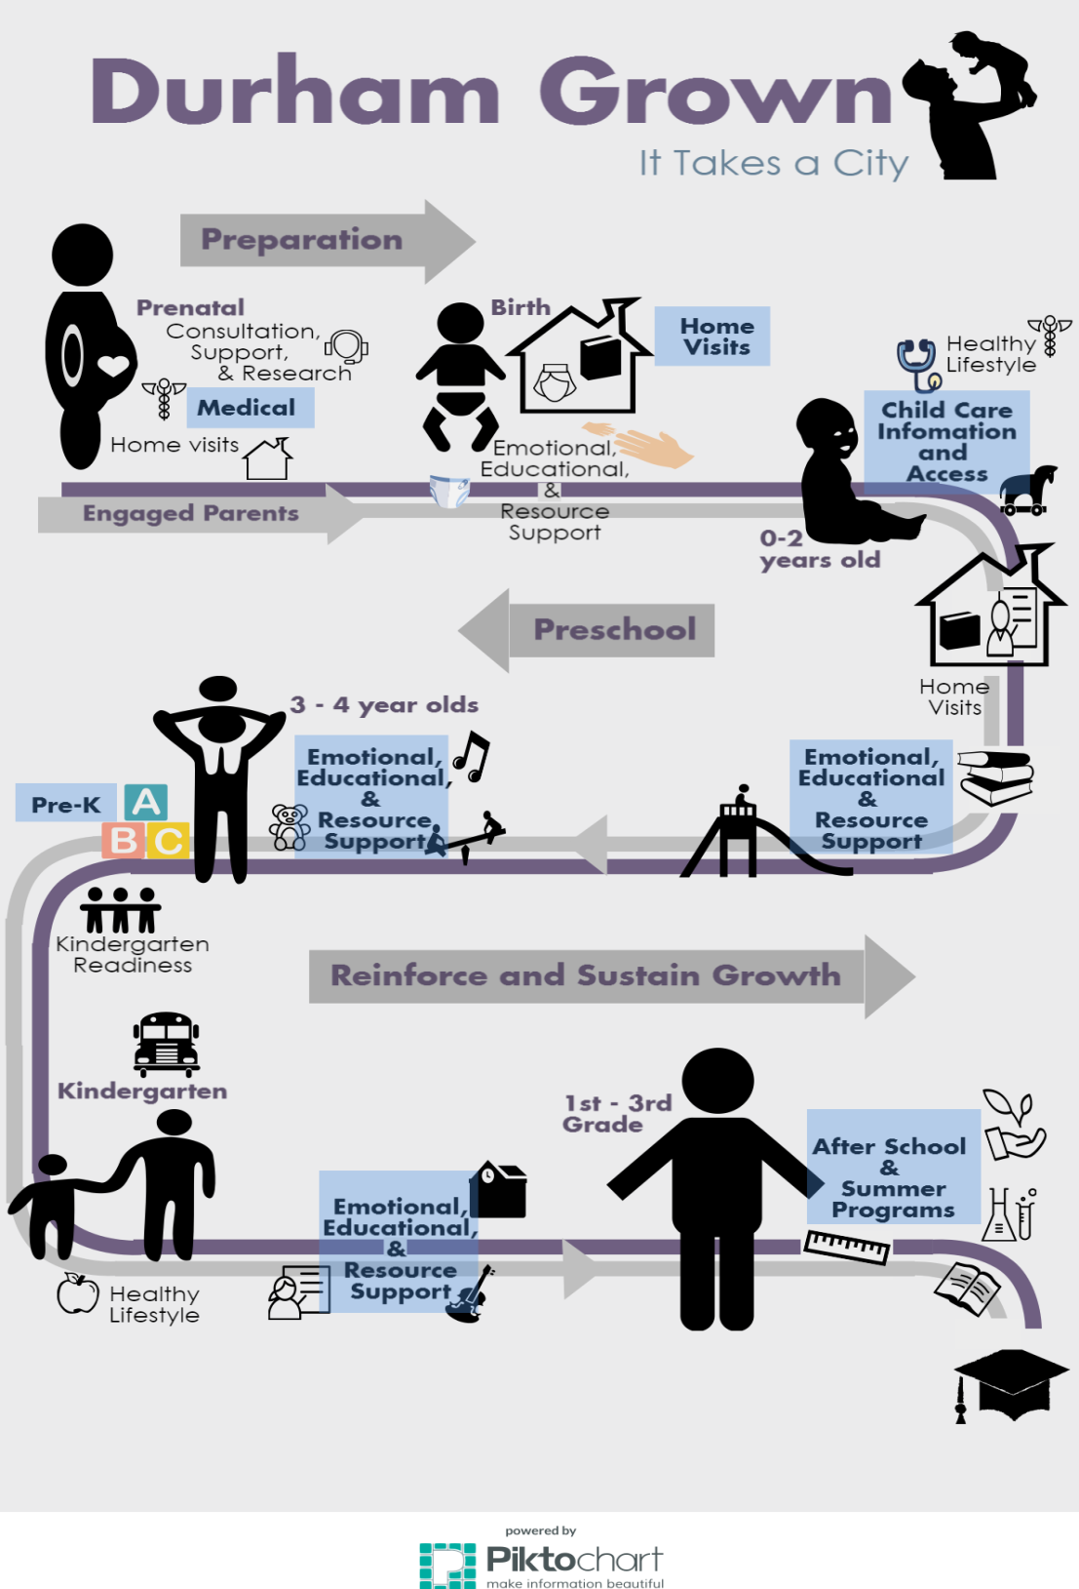


Slide 25

RECOMMEND

Slide 26
Overall recommendations
Serve all 3- and 4-year-olds in Durham County in high-quality preschool by 2023
First serve 4-year-olds, prioritizing children in low-income families, by August 2019
NOTE: Additional data is being collected to better understand which children are likely to arrive less ready for Kindergarten.

Slide 27
Overall recommendations
Centralize administration of new publicly funded pre-K services
Office that manages Durham’s existing NC Pre-K Program services– Durham’s Partnership for Children (DPFC)

Slide 28
Overall recommendations
Fund new services in the range of $11,500–$12,000 per child per 10-months
Adhere to the existing NC Pre-K Program quality standards
Add more rigorous standards
Specific details are presented later
Not inclusive of evaluation costs and some start-up costs (e.g., administration)

Slide 29
Overall recommendations
Conduct a thorough analysis of the demand for and supply of preschool in Durham County
Durham needs information about parents’ preschool preferences and arrangements
Such a study could seek to understand the value many parents place on preschool education and the needs of families who are not currently using childcare or preschool programs

Slide 30
Overall recommendations
Create a small and efficient infrastructure for the next phase of the work
Gather input from the local stakeholders
Coordinate with early childhood media campaigns
Obtain private funding for start-up and professional development costs

Slide 31

QUALITY

Slide 32
Proposed new standards
(Minimal financial impact)
 | New Standard
Classroom environment | Initiate a process to assess curriculum choice system-wide
Monitoring classrooms | Increase the frequency of site visits to ensure compliance with proposed new standards Provide responsive technical assistance
cont’d

Slide 33
Proposed new standards
(Minimal financial impact)
 | New Standard
Support programs to increase family engagement | Provide additional family support to increase shared decision-making and authentic governance
Child-level formative and program-level assessment | Expand system-wide infrastructure for online assessments to share information with K–3 teachers (guide instruction) Build model for programs to have continuous improvement strategies at program level

Slide 34
Proposed new standards
(Significant financial impact)
 | New Standard
Teacher/administrator professional development | Expand professional development in frequency and depth
Mentoring and coaching | Expand intensive mentoring and coaching to teachers and administrators, including peer-to-peer strategies
cont’d

Slide 35
Proposed new standards
(Significant financial impact)
 | New Standard
Workforce compensation | Create standard compensation that matches Durham Public Schools’ scale for certified teachers, at entry and as experience grows, in order to reduce turnover
Teacher-child interactions | Measure teacher-child interactions using Pre-K CLASS®
cont’d

Slide 36
Proposed new standards
(Significant financial impact)
 | New Standard
Multilingual capacity | Consider bilingual staffing standards to support dual language learners Provide materials and communication in child’s home language
Teacher-child ratio in classes with children with special needs | Consider a lower teacher to child ratio, such as 1:8, to support children with special needs in blended classrooms Establish guidelines for the number of children with special needs included in classrooms with typically developing children
cont’d

Slide 37
Proposed new standards
(Significant financial impact)
 | New Standard
Program infrastructure | Build infrastructure to accommodate expanded system, including quality assurance, data collection, and evaluation

Slide 38
FINANCING

Slide 39
Financing
 | NC Pre-K Program State Funds | Smart Start State Funds | TOTAL MONTHLY Reimbursement to Provider Per Child | TOTAL ANNUAL (10 mo.) Reimbursement
5-star with B–K teacher in private child care | $650 | $294 | $944 | $9,440
5-star without B–K teacher in private child care | $600 | $324 | $924 | $9,240
4-star with B–K teacher in private child care | $650 | $233 | $883 | $8,883
4-star without B–K teacher in private child care | $600 | $273 | $873 | $8,730
DPS (all classrooms with B–K teacher) | $320 | N/A | $320 (additional funding Title I) | $3,200
Durham Head Start | $300 | N/A | 300 (additional funding Head Start) | $3,000

Slide 40
Financing
Proposed cost per student of $11,500–$12,000 per year
Estimated unmet need: 1,136 Durham 4-year- olds each year from low-income households
Estimated number of 4-year-olds in near poverty, <200% Federal Poverty Level: 2,091

Slide 41
Financing
Cost to raise quality and expand services to all low-income 4-year-olds: $14.5m–$15.5m
Cost to expand to the 1,136: $13.1m–$13.6m
Cost to raise the quality for the 955: $1.4m–$1.9m (additional $1,500–$2,000 per student above current expenditures)
Additional expenses related to start-up costs, program administration, and evaluations are not included in this estimate

Slide 42
Strategies for funding
Local Financing Options
Item in local budgets
Local sales tax
Durham has fully exercised this option
Approximately $13.3 is raised from Durham’s ¼ cent sales tax
Of this, about $484,270 is allocated to pre-K

Slide 43
Strategies for funding
Local Financing Options (cont’d)
Property tax increases
1 cent increase results in about $3.5m
Bonds
To secure funding for capital needs
Title I funds in DPS
Currently fully allocated for pre-K and other needs
Sliding fee scale
To support a portion of costs
Begin at 200% of Federal Poverty Level

Slide 44
Strategies for funding
Local Options that Require State Action
Occupancy tax
Tax on sugar-sweetened beverages
Allocation of fees
Collect fees for expanded set of purposes, such as building permit fees
Social Impact Bonds, also known as Pay for Success
Pay an external entity once results delivered
Requires in-depth feasibility study

Slide 45
Strategies for funding
Private Funding Options
Philanthropy
Best for nonrecurring needs, matching dollars, capacity building
Annual fundraising events

Slide 46
OUTREACH

Slide 47
Outreach
Advocacy Campaign
By August 2017, the Outreach Subcommittee, with support from Duke University’s Office of Durham and Regional Affairs, will:
Publish a brief summary of the Task Force’s work
Create handouts and other materials
Host two information sessions for the public
Integrate public feedback from info sessions into the Task Force’s final report

Slide 48
EVALUATION

Slide 49
Evaluation
Does the program work?
Program self-assessment: Gather information about student learning and development
Program evaluation: Gather information to make judgments about a program, to improve effectiveness
Not included in the Task Force’s cost estimation
Evaluations are usually conducted by independent evaluators and may cost between 10‒15% of the cost of the program

Slide 50
Evaluation
Formative evaluation is useful for determining how the program should be designed or improved and how it is being implemented
Possible questions:
What is the process for getting the program started across program locations?
Does it reach the target students?
Are intended services being provided?

Slide 51
Evaluation
Summative evaluation asks big questions about whether a program “works”
Possible questions:
Are the children who participate more ready for kindergarten than those who do not?
What is the average level of classroom quality in Durham’s Pre-K Program?
Are children in higher-quality classrooms more ready than children in lower-quality classrooms?

Slide 52
NEXT STEPS

Slide 53
Next steps
The commitment of the members of the Task Force to the work is complete
Fund personnel to lead the next phase

Slide 54
Next steps
Assess the demand for expanding high-quality preschool in Durham
Study supply of care and identify gaps in services
Poll parents
Identify barriers
Assess the impact of expanded high-quality pre-K for 4-year-olds on existing early education programs for birth to 3-year-olds

Slide 55
Next steps
Increase public knowledge and will to fund activities that support kindergarten readiness
Conduct targeted outreach
Ensure the inclusion of parent input
Create targeted media campaigns
Consider Whitted School as a pilot site for evaluation and research

Slide 56

QUESTIONS?

Slide 57

Durham’s Community Early Education/Preschool Task Force

